Slide 1



Speech Emotion Recognition Using Machine Learning (ML)
PROJECT PROPOSAL
Module Code : IT2011
By Project Group No. : 196

Slide 2
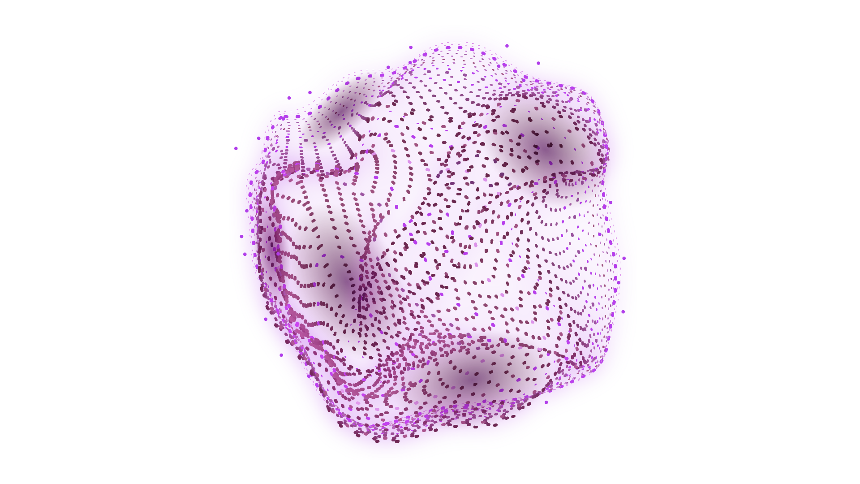
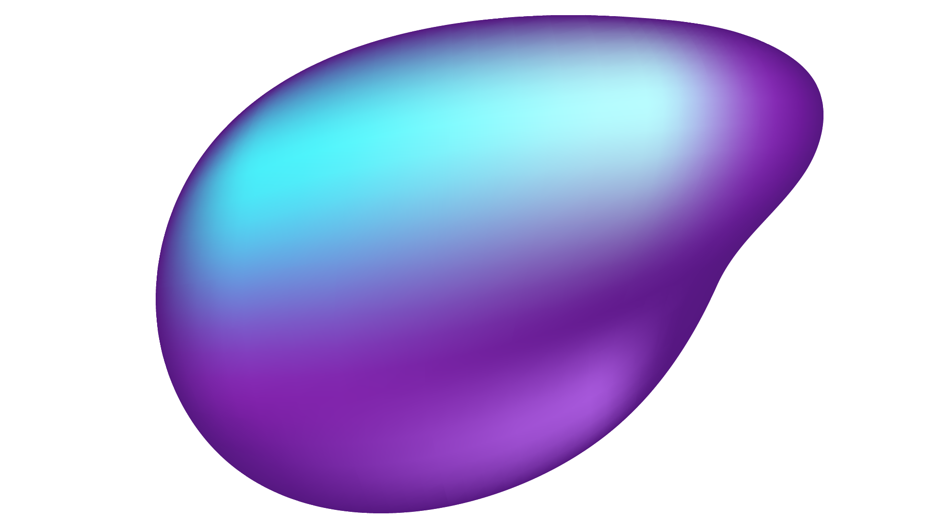
Project Group No. 196 - Group Members
Registration No. | Name of Members
IT24102699 | Mummullage B.U.T
IT24102758 | Priyamalka W.D.N
IT24102784 | Panagodage N.M.H
IT24102773 | Siriwardane K.D.D.D
IT24102795 | Alahakoon A.M.J.P
IT24102798 | Sooriyabandara U.R.G.W.K

Slide 3
TABLE OF CONTENTS
01
02
03
04
05
What Is AI And ML?
A Little To Know About
AI And ML
Problem Domain Identification
About The Problem Domain
And The Objectives
Datasets And RAVDESS
Let’s Get To Know About
Datasets And RAVDESS
More About RAVDESS
Why RAVDESS Is Better
Alternative Datasets
Learn About Other Datasets
06
Expected Outputs And Conclusion
Final Expectations And A Little Overview About Project

Slide 4

01
What Is AI And ML?
It’s Better To Understand The Background First!

Slide 5
What Is Artificial Intelligence (AI)?
Artificial Intelligence (AI) is simply a field focused on
Building Systems with the Ability to
Simulate Human Intelligence.

Slide 6
What Is Machine Learning (ML)?
Machine Learning (ML) is a Subset of AI where Computer Systems learns from Data and improve their Performance without Explicitly Programmed.

Slide 7
02
Problem Domain Identification
Let’s Dive Deep Into The Matter!

Slide 8
SPEECH EMOTION RECOGNITION Domain Identification
01.
Speech Processing/
Audio Signal Processing
02.
Affective Computing
The Technical Field That Deals With Extracting And Analyzing Features From Voice/Audio Data
A Subfield Of AI Focused On Detecting, Interpreting, And Responding To Human Emotions

Slide 9

SPEECH EMOTION RECOGNITION Real World Problem
While Humans Can Naturally Pick Up On Emotions In Speech, Machines Cannot Inherently Understand Emotions.
This Inability Leads To Limitations In Automated Systems As,
Voice Assistants – Giving
Tone-deaf Responses.
Customer Service Bots –
Failing To Notice Frustration Or Urgency.

Slide 10
SPEECH EMOTION RECOGNITION Applications In Real World
CUSTOMER SERVICE
AI ASSISTANTS
HEALTHCARE
Detect Stress Or Depression In Telehealth Sessions To Alert Doctors Early
Identify Frustration Or Anger In Real Time To Escalate Calls To A Supervisor
Respond With Empathy Based On The Detected Mood Of The User

Slide 11
Objectives Of This Project
Our Goal Is,
To Design, Train, And Evaluate…
A Speech Emotion Recognition System That Can Accurately Classify Emotions From Voice Recordings.

Slide 12
Objectives Of This Project
Model Development
Dataset Utilization
Performance Evaluation
Future Readiness
Build A Machine Learning Model That Can Identify Multiple Emotions From Audio Input
Use A Dataset, Which Contains Balanced, High-quality Emotional Speech Samples
Test The Model On Unseen Data To Ensure Reliability And Generalization
Design The System So It Can Later Be Integrated Into
Real-time Applications
01
02
03
04

Slide 13
03
Datasets And RAVDESS
Let’s Get Familiar With Datasets!
And About RAVDESS Too!

Slide 14
What Is A Dataset?
A Dataset Is A Structured Collection Of Data Organized For Analysis
A Dataset Can Be,
Simple As A Table With Rows (Records) And Columns (Attributes)
Or
In Other Formats (CSV Files, JSON, SQL Databases, Excel Spreadsheets)

Slide 15
Purpose And Importance Of Datasets
Purpose
Importance
The Primary Purpose Of A Dataset Is To Provide A Foundation For Analysis And Modeling
Datasets Are Really Important When It Comes To,
Training Machine Learning Models
Identifying Trends
Testing Hypotheses

Slide 16
RAVDESS
RAVDESS - Ryerson Audio-visual Database Of Emotional Speech And Song
RAVDESS Is Specifically Designed For Emotional Speech Research, Making It Perfectly Aligned With This Speech Emotion Recognition Problem
This Dataset Includes A Wide Range Of Emotions,
Calm
Happy
Sad
Angry
Fearful
Disgust
Surprised
Neutral

Slide 17
04
More About RAVDESS
The Reasons To Choose RAVDESS Over Others!

Slide 18
RAVDESS – A Little More…
The RAVDESS was developed by Dr Steven R. Livingstone, and Dr Frank A. Russo.
This is published in Kaggle (Limited Files) and as well as in Zenodo (Full Version).
RAVDESS From Kaggle
https://www.kaggle.com/datasets/uwrfkaggler/ravdess-emotional-speech-audio
RAVDESS FROM Zenodo
https://zenodo.org/records/1188976

Slide 19
RAVDESS – Dataset Justification
01. Features
What Is Meant By A Feature In This Project?
Features Are Numerical Properties Extracted From Audio Files That Represent Meaningful Characteristics Of Speech.

Slide 20
RAVDESS – Dataset Justification
01. Features
How Audio Energy Is Distributed Across Frequencies
Rhythm, Stress, And Intonation Patterns In Speech
Energy (Loudness)
MFCCs
Pitch
Capture The Timbral Aspects Of Speech Similar To Human Hearing Perception
Spectral Features
Voice Frequency, Which Can Indicate Excitement, Anger, Or Sadness
Prosodic Features
Higher Energy May Indicate Anger Or Excitement; Lower May Indicate Sadness Or Calmness

Slide 21
RAVDESS – Dataset Justification
02. Target Variable
Emotion Label : One Of The Eight Emotion Categories:
Calm
Happy
Sad
Angry
Fearful
Disgust
Surprised
Neutral
This Is The Output Our Model Will Predict Based On The Input Features

Slide 22
RAVDESS – Dataset Justification
03. Size and Quality
Size
Quality
Studio-grade Recording Conditions.
Clear Articulation With Consistent Background And Microphone Setup.
Balanced Distribution Of Emotions And Genders.
1,440 Speech Audio Files.
24 Professional Actors (12 Male, 12 Female).
Sampling Rate: 48 kHz, 16-bit Wav Format.

Slide 23
05
Alternative Datasets
RAVDESS Is Not The Only Star!

Slide 24
Alternative Datasets
01
02
03
CREMA-D
SAVEE
TESS
Crowd-Sourced Emotional Multimodal Actors Dataset
Pros :
More Actors And Accent Diversity
Cons :
Some Background Noise, Less Controlled Recording Environment
Surrey Audio-Visual Expressed Emotion
Pros :
High-quality British English Recordings
Cons :
Only Male Voices And Fewer Emotion Categories
Toronto Emotional Speech Set
Pros :
Very Clean Audio Quality
Cons :
Only Female Voices Therefore Lacks Gender Diversity

Slide 25
Alternative Datasets
01
02
03
CREMA-D
SAVEE
TESS
Crowd-Sourced Emotional Multimodal Actors Dataset
Dataset Link :
https://www.kaggle.com/datasets/ejlok1/cremad
Surrey Audio-Visual Expressed Emotion
Dataset Link :
https://www.kaggle.com/datasets/ejlok1/surrey-audiovisual-expressed-emotion-savee
Toronto Emotional Speech Set
Dataset Link :
https://utoronto.scholaris.ca/collections/036db644-9790-4ed0-90cc-be1dfb8a4b66

Slide 26
06
Expected Outputs And Conclusion
Let’s See What We Get!
Oh! And An Overview Too!

Slide 27
Expected Outputs
0%
ACCURACY
More than 80%

Slide 28
Expected Outputs
80%
ACCURACY
More than 80%

Slide 29
Expected Outputs
Primary Outcome:
A Trained Machine Learning Model Capable Of Accurately Classifying Emotions From Speech Recordings.
Target Performance:
Aim For More Than 80% Accuracy On Unseen Test Data From The RAVDESS Dataset.
Output Format:
Emotion Label (E.G., Happy, Sad, Angry, Calm, Etc.)
Confidence Score / Probability For Each Possible Emotion.

Slide 30
01. What AI/ML Is?
02. Problem Domain Identification
03. About Datasets And RAVDESS
Simply, Giving The Machines The Ability To Simulate
Human Intelligence
Conclusion
A Speech Emotion Recognition
System Is Developed For Where Real
World Problems Can Occur Like,
Healthcare, Customer Service, And
AI Assistants
A Dataset Is A Structed Collection Of Data.
And Our Dataset Is RAVDESS

Slide 31
04. More about RAVDESS
05. Alternative Datasets
06. Expected Outputs
A Discussion About The Features, Target Variable,
Size And Quality Of RAVDESS
Conclusion
There Are More Than RAVDESS To Use As A Backup.
Such As, CREAMA-D, SAVEE, and TESS
A Finalized Working Model With
More Than 80% Accuracy

Slide 32
THANK YOU!

